Slide 1

Student Digital Portfolio
Student Name: M.Naseema banu
Register No & NMID: 24134130500122011/ NMID:asanm41341324213011
Department: BCA
College/university:Deen college of arts and science/annamalai university
‹#›
Notes:
‹#›

Slide 2

PROJECT TITLE
Student Portfolio Website (HTML, CSS, JavaScript)
‹#›

Slide 3



AGENDA
Problem Statement
Project Overview
End Users
Tools and Technologies
Portfolio design and Layout
Features and Functionality
Results and Screenshots
Conclusion
Github Link
3/21/2024 Annual Review
‹#›

Slide 4

PROBLEM STATEMENT
Students often rely on traditional resumes, which are static and limited in showcasing skills, projects, and achievements.
A student portfolio website provides an interactive, professional, and accessible platform for recruiters, teachers, and collaborators.
‹#›

Slide 5

PROJECT OVERVIEW
This project is a responsive personal portfolio website designed for students.
It contains sections like About Me, Skills, Projects, Resume, and Contact.
The website is built with HTML, CSS, and JavaScript and is hosted online for easy acces
‹#›

Slide 6

WHO ARE THE END USERS?
Students (to showcase skills & projects)
Recruiters (to evaluate candidates)
Freelancers (to attract clients)
Universities / Professors (for academic evaluation)
‹#›

Slide 7

TOOLS AND TECHNIQUES
Frontend: HTML5, CSS3, JavaScript
Hosting: GitHub Pages / Netlify
Design: Figma / Canva (wireframes)
Version Control: Git & GitHub
‹#›

Slide 8
POTFOLIO DESIGN AND LAYOUT
Clean, minimalist slide design
Diagrams for system architecture
Screenshots of prototype dashboards
Clear separation of sections
‹#›

Slide 9
FEATURES AND FUNCTIONALITY
Real-time waste bin monitoring
Automated alerts for collection
AI-based route optimization
Mobile app for municipal staff
Analytics dashboard for admins

Slide 10
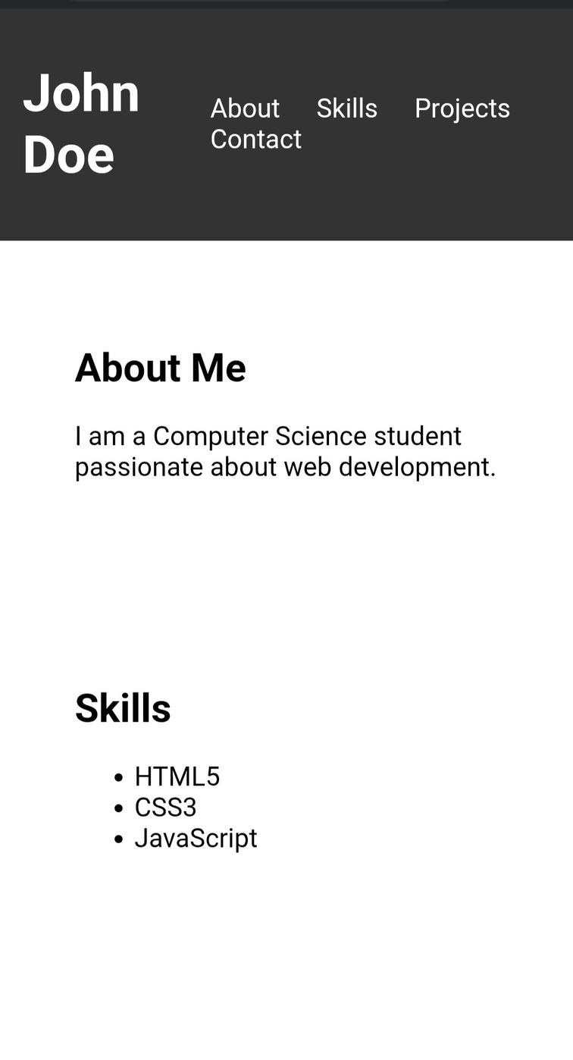
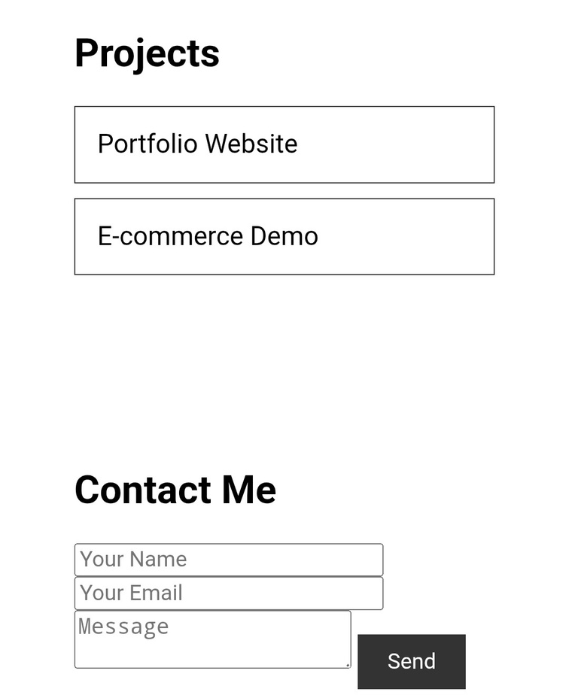

RESULTS AND SCREENSHOTS
3/21/2024 Annual Review
‹#›

Slide 11
CONCLUSION
The Student Portfolio Website allows students to showcase their skills interactively.
It enhances job opportunities, freelancing prospects, and academic recognition.
Future improvements: Add blog section, integrate backend with Node.js.
‹#›

Slide 12
GitHub Link
https://github.com/dcca24naseema-banu/Naseema-TNSDC-FWD-DP.git
Notes:
‹#›

